Slide 1
E-commerce Cart System
Simplifying Online Shopping with Efficient Cart Management
Kunal Digdeotulwar
Nikhil Ade

Slide 2
IntroDuction
What is an E-commerce Cart System?
A core component of online shopping platforms that enables users to manage selected products before making a purchase.
It functions as a digital shopping basket, holding products that users intend to buy.
Allows for modifications such as adding, removing, or updating quantities of items.
Importance of an E-commerce Cart System:
Enhances User Experience:
Simplifies shopping by allowing users to review and manage their product selections in one place.
Provides an easy way to view the total cost of selected items, including taxes and discounts.

Slide 3
Critical for Sales Conversions:
Acts as the last step before checkout, where many customers finalize their purchases.
A well-designed cart reduces abandonment rates, leading to higher revenue.
Supports Order Organization:
Offers a clear overview of orders, ensuring that users can confirm their selections.
Key Characteristics of Modern E-commerce Cart Systems:
Real-time Updates: Reflects changes (e.g., adding/removing items) instantly.
Mobile Responsiveness: Adapts to different screen sizes for seamless shopping on any device.
Integration with Payment Systems: Ensures secure and fast transactions.
Personalization: Displays recommendations and discounts based on user behavior.

Slide 4
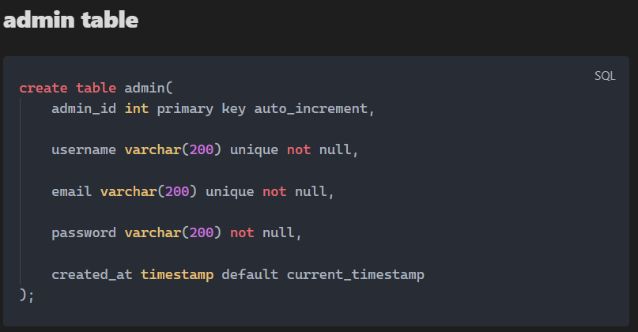
Database
Database Schema

Slide 5
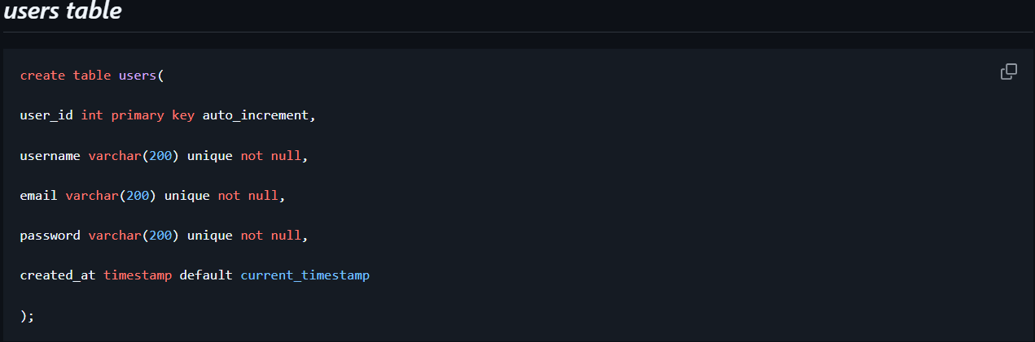

Slide 6
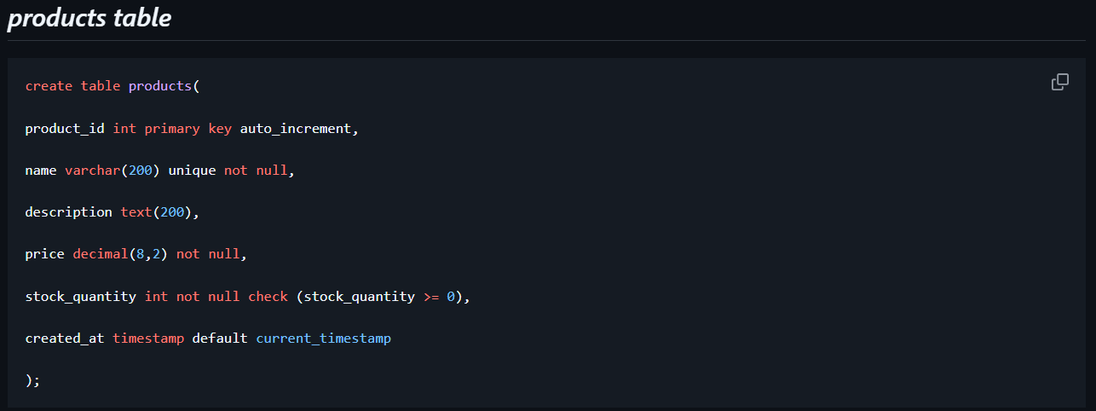
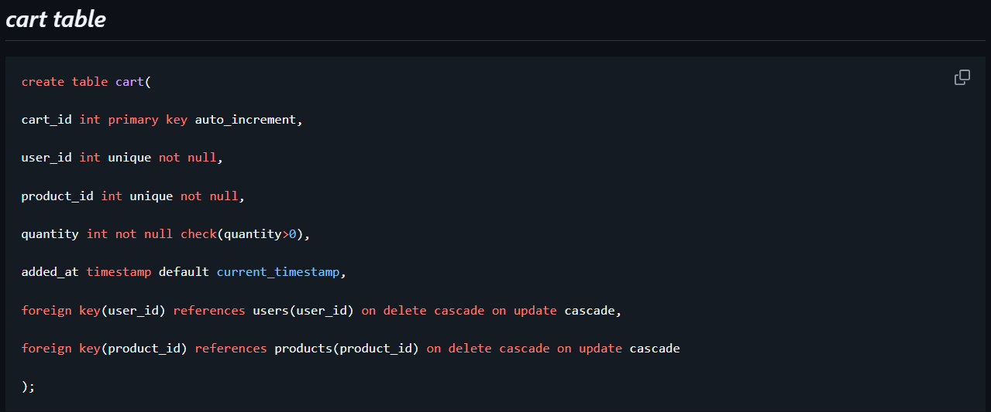

Slide 7
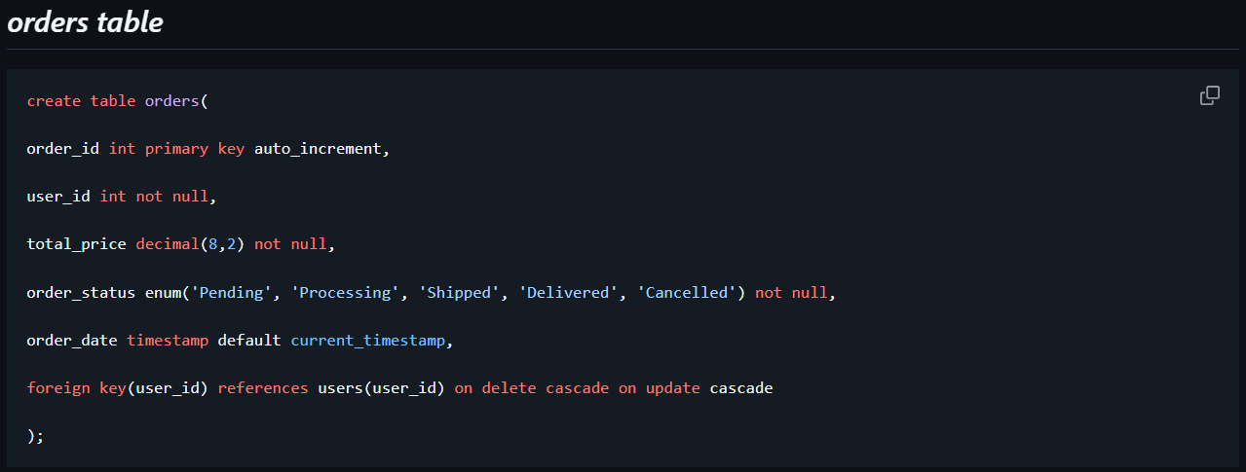
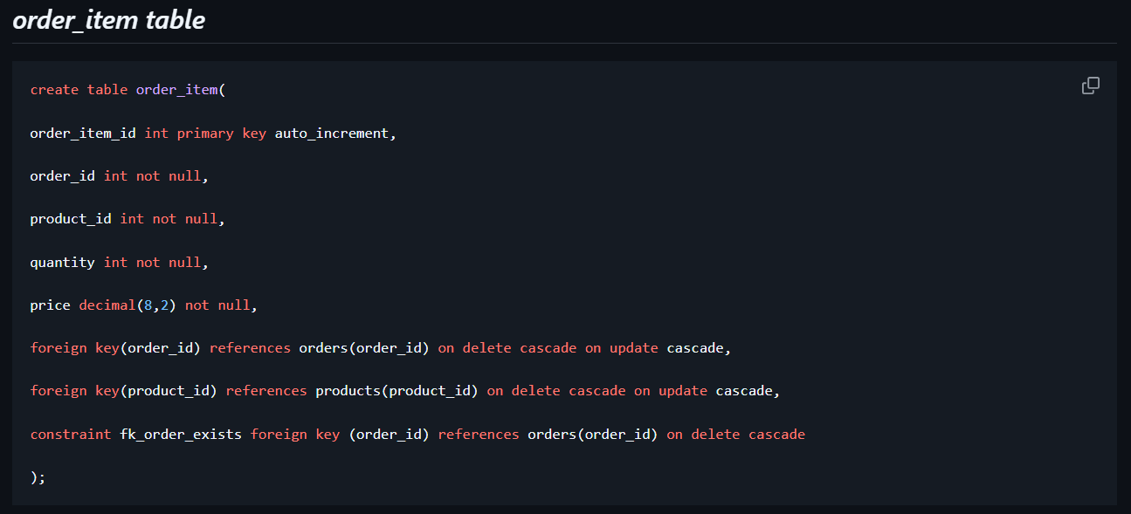

Slide 8
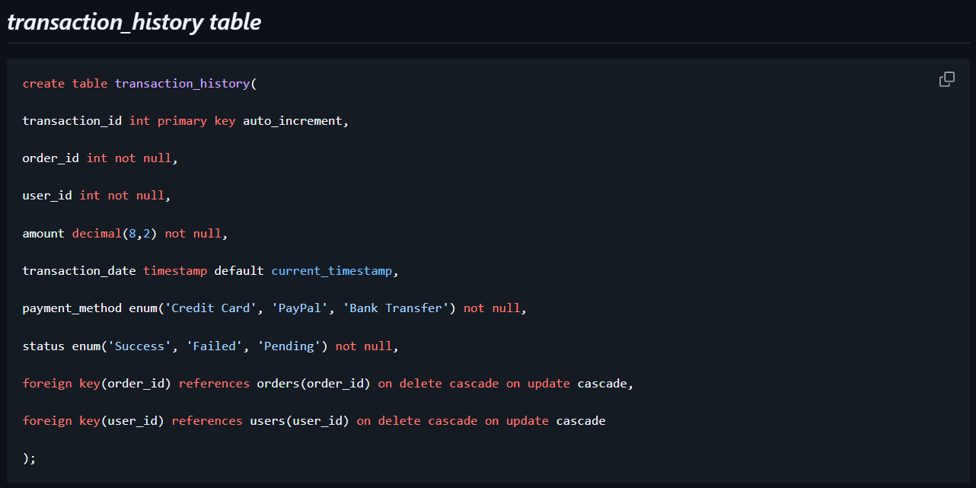

Slide 9
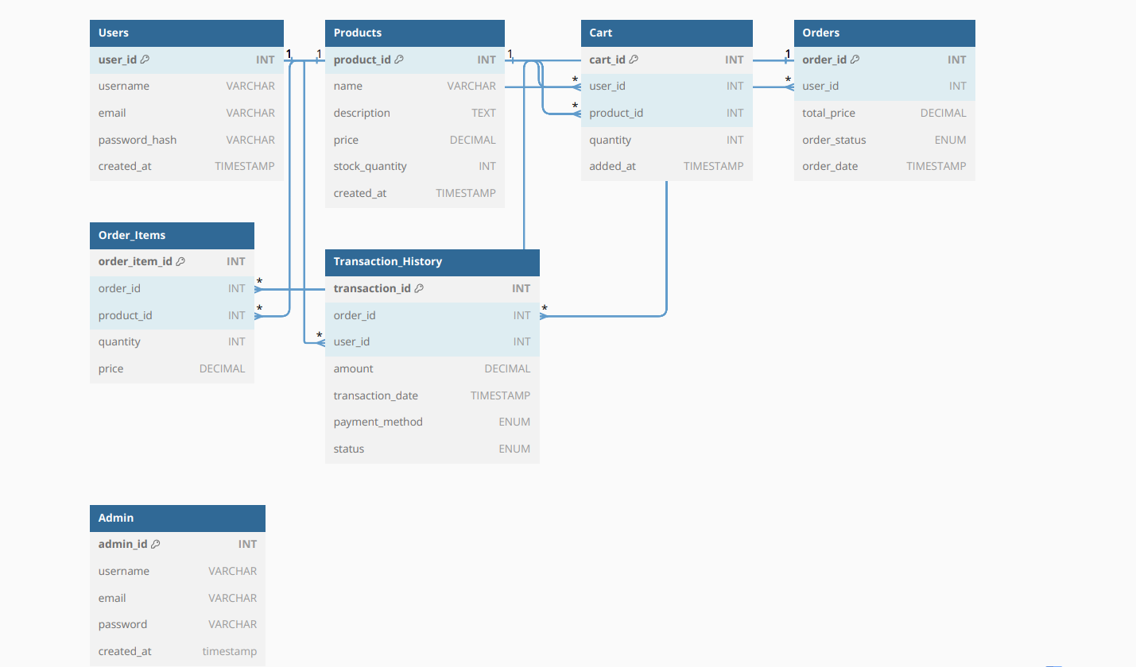
Diagram

Slide 10
Workflow
Add Products to Cart
User Action:
The user browses the product catalog and selects a product they wish to buy.
The user specifies the quantity and clicks the "Add to Cart" button.
System Action:
The system checks the Products Table to validate if sufficient stock is available.
The product details, including user_id, product_id, and quantity, are added to the Cart Table.
A confirmation message is displayed to the user: "Product successfully added to your cart."

Slide 11
View Cart
User Action:
The user can navigate to the Cart Page to review the products they have added.
System Action:
The system retrieves data from the Cart Table for the logged-in user, showing:
Product name
Quantity
Price per item
Total price for each product (calculated as price × quantity).
The grand total price is calculated and displayed dynamically.

Slide 12
Update Cart
User Action:
The user can increase, decrease, or delete products from their cart.
Options available:
Increase Quantity: Adjust product count (e.g., from 1 to 2).
Decrease Quantity: Reduce product count.
Remove Product: Remove a specific product entirely from the cart.
System Action:
When the user updates the cart:
The system validates stock availability for quantity changes.
Updates the Cart Table to reflect the new quantity or product removal.
Recalculates the total price for each product and the grand total.
Displays a confirmation message like "Cart updated successfully."

Slide 13
Validate Stock Availability
System Action:
Before checkout, the system checks the Products Table to ensure the stock quantity meets the cart's requirements.
If stock is insufficient:
A message is shown: "Sorry, the selected quantity exceeds available stock.“
The user must adjust the quantity accordingly.
Proceed to Checkout
User Action:
Once satisfied with the cart, the user clicks "Proceed to Checkout".
System Action:
The system prepares order details by summarizing the products, quantities, and total price.
The cart data is temporarily stored to create an order in the Orders Table.
The system redirects the user to the Payment Page to finalize the purchase.

